Slide 1
Climate Change Issues, Challenges, and Initiatives: Perspectives from the Archipelagic State of Indonesia
Achmad Poernomo
Senior Advisor to Minister on Public Policy
Ministry of Marine Affairs and Fisheries
Presented at OCEANS DAY AT COP 21, Rio Conventions Pavilion, Paris, 4 December 2015

Slide 2
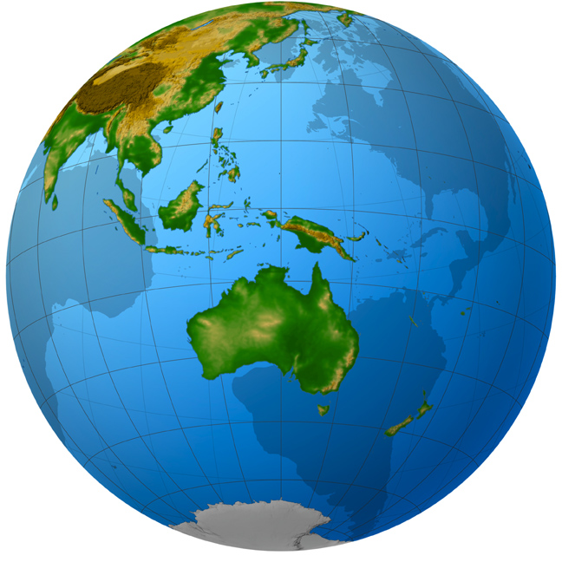
INDONESIA
Archipelagic country of 17,504 islands (10,000 small islands), right at the equatorial line;
Flanked by 2 oceans (Indian and Pacific) and 2 continents (Australia and Asia)
The 2nd longest coastline in the world, 95,181 km, 5.8 million km² of sea and , 1.9 million km² of land
140 millions out of 250 millions Indonesians are living in coastal area, contained in 297 districts/cities (of 440 total districts/cities).
Home for 8,500 fish species, (~ 37% of world’s), 555 seaweed species and 950 coral species

Slide 3
MAIN ISSUES
SEA LEVEL RISE AND OCEAN WARMING
1. COASTAL VULNERABILITY
2. COASTAL ECOSYSTEM DEGRADATION
3. SINKING ISLANDS AND CITIES (2000 SMALL ISLANDS IN 2050)
4. CORAL BLEACHING
FRAGILE COASTAL COMMUNITY LIVELIHOOD
1. LOSS OF HOME FOR 42 MILLIONS IN 2050
2. LOSS OF INCOME RESOURCES
3. UNCERTAINTY IN FISHING SEASONS
4. EMERGING HUMAN DISEASES
THREATENED FISHERIES AND AQUACULTURE
1. CHANGES OF FISH MIGRATION PATTERN
2.INCREASE NUMBERS OF STRANDED FISH
3. EMERGING FARMED FISH DISEASES

Slide 4
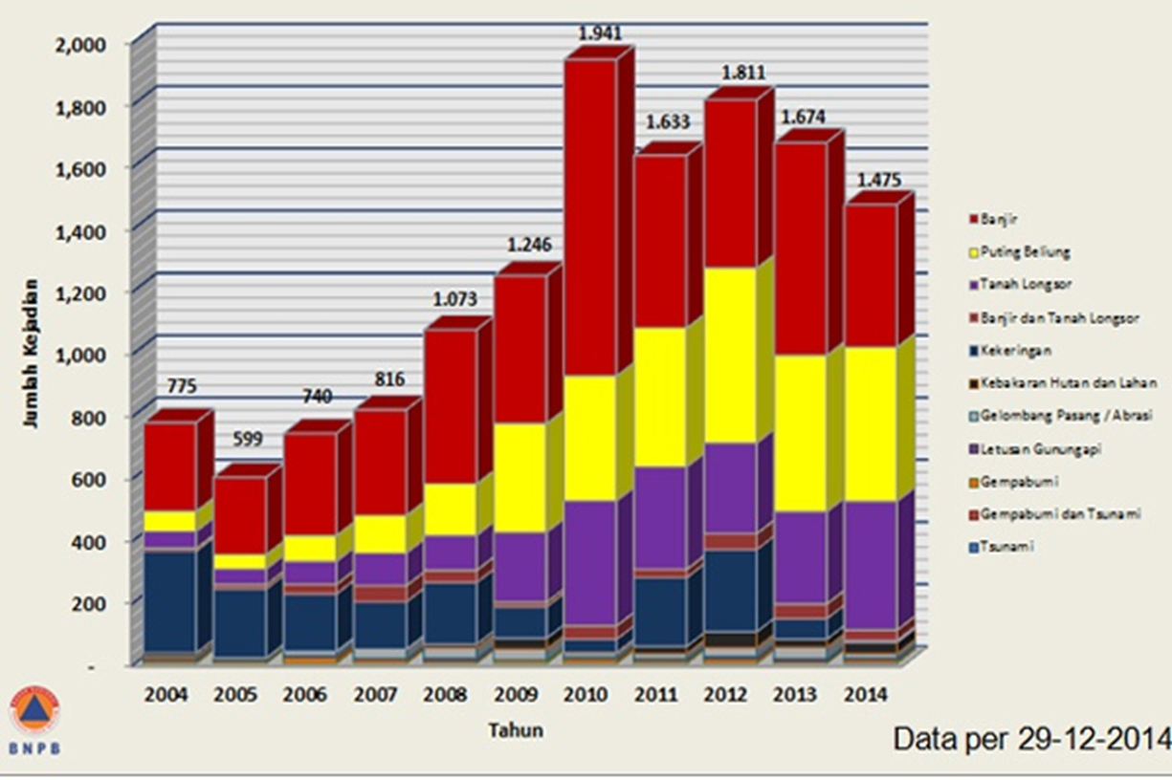
challenges
Mechanisms from hazards to disaster are not fully understood (lack of knowledge, technology and resources);
Natural supporting capacity is getting more and more vulnerable;
People are powerless;
Early Warning System (EWS) is not properly functioning nor exist;

Slide 5
INITIATIVES

Slide 6
1. IMPROVING CAPACITY, KNOWLEDGE AND SERVICES
INDONESIA PRIMA
(INA PRIMA)
MARINE INTEGRATED DATA AND ANALYSIS SYSTEM (MIDAS)
COASTAL INUNDATION FORECASTING DEMONSTRATION PROJECT (CIFDP)
YEAR OF THE MARITIME CONTINENT (YMC) 2017
FISHER AND FISH FARMER PROTECTION LAW

Slide 7
2. PROMOTING SUSTAINABLE DEVELOPMENT AND MANAGEMENT OF OCEAN AND COASTAL SERVICES
BLUE OCEAN
BLUE CARBON
BLUE ECONOMY
CORAL TRIANGLE INITIATIVE

Slide 8
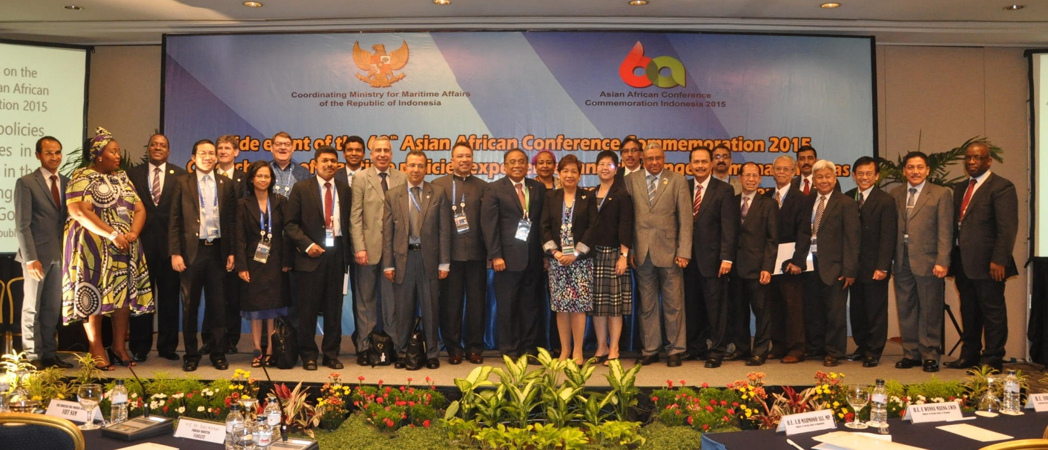
3. INDONESIA AND SMALL ISLANDS DEVELOPING STATES
COMMON CONCERNS
SINKING ISLANDS,
MARINE DEBRIS,
VULNERABLE COASTAL ECOSYSTEM AND POPULATION
OPPORTUNITIES FOR COLLABORATION
CAPACITY BUILDING (TRANSFER TECHNOLOGY AND KNOWLEDGE)
SHARING EXPERIENCES
INTERNATIONAL SUPPORTS

Slide 9
Closing Remarks
Too much focus has been given on land which in fact only 30% of our earth, absorbing only 10% of heat, and recycles less than 7% of CO₂ in the atmosphere within more than 200 years.
Our ocean that embodies the key answer to the problem of climate change is left far behind,
Ocean is very extensive, challenging, and poses a wide variety of problems. Archipelagic states and SIDS suffer most of climate change impacts.
Archipelagic states and SIDS (and others such as IORA) can work together to tackle common issues of climate change

Slide 10
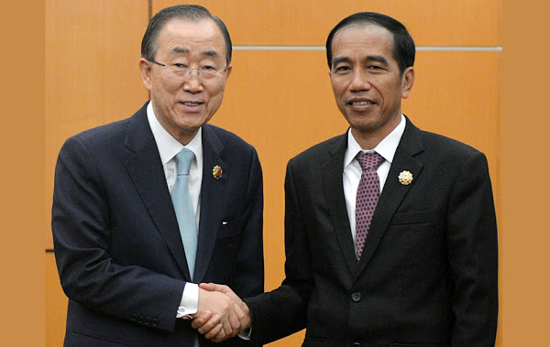
We could be the first generation to end poverty, but being the last generation that respond to the problem of climate change
We are committed to reduce emission by 29% (self support) or 41% (with international support) in 2030
Thank You

